Slide 1
chatting robot
Client&Server System
Instructor: Dr. Richard Lomotey
Ruochi Zhang, Jingyuan Wei

Slide 2

Thorough description of the project
Our project designed a automatic reply system for a very popular chatting app among Asian people which called “wechat”. Users can use this client server system to log in their own account and perform many functions.
Here are the functions and open source corpus that we use:
Using a Chinese language processor introduced from “tuling” database and Baidu translation api from Baidu platform to realize auto-reply in English.
A automatic make-up function for portrait photograph based on facial recognition and image processing method.
A PDF OCR function to transform literature content in PDF file to txt form.

Slide 3


Main open source parallel corpus(OPUS) and database we use.
Baidu translation api from Baidu platform Function : English to Chinese
“TULING” Chinese corpus.(Named after computer scientist Alan Turing). Function : Auto reply
http://www.tuling123.com/v1/kb/select

Slide 4
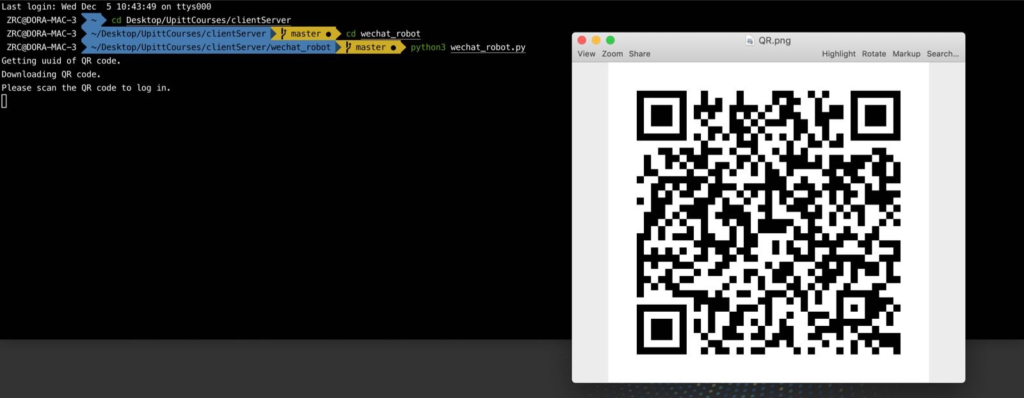
Log in your account to use this robot in wechat

Slide 5
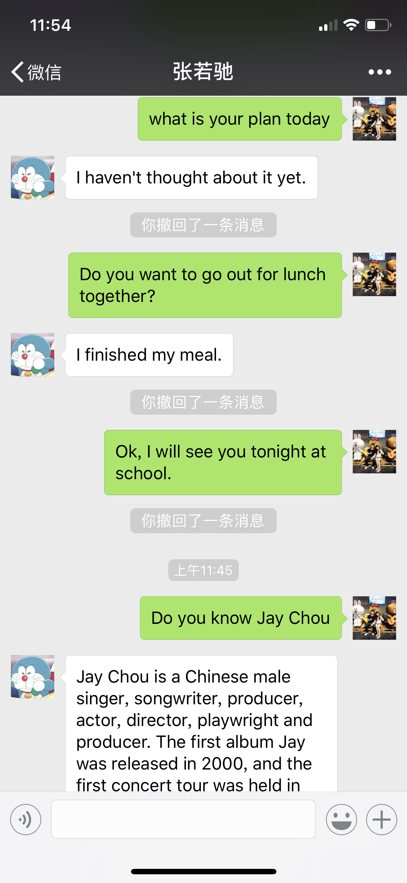
Function Demo-Part I : Auto Reply in English

Slide 6

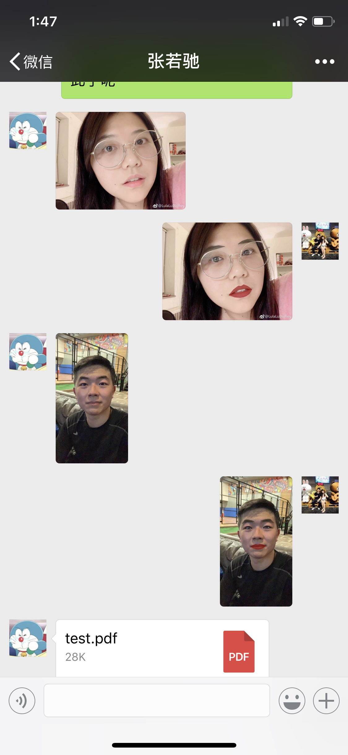

Function Demo-Part II : Auto make-up for pictures
Before
Automaticly detect eyes, eyebrows and lips.
After
Add make-ups for eyebrow, eye lines and lips.

Slide 7
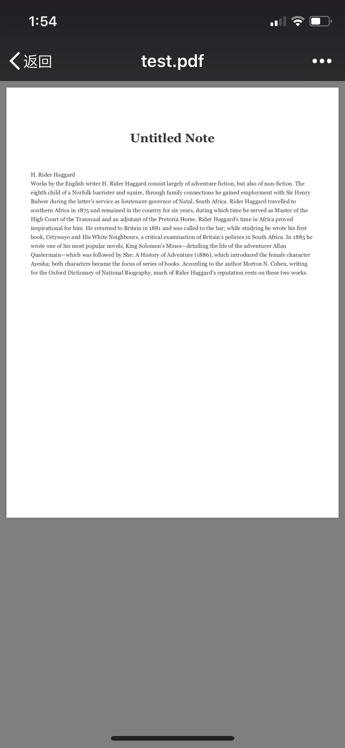
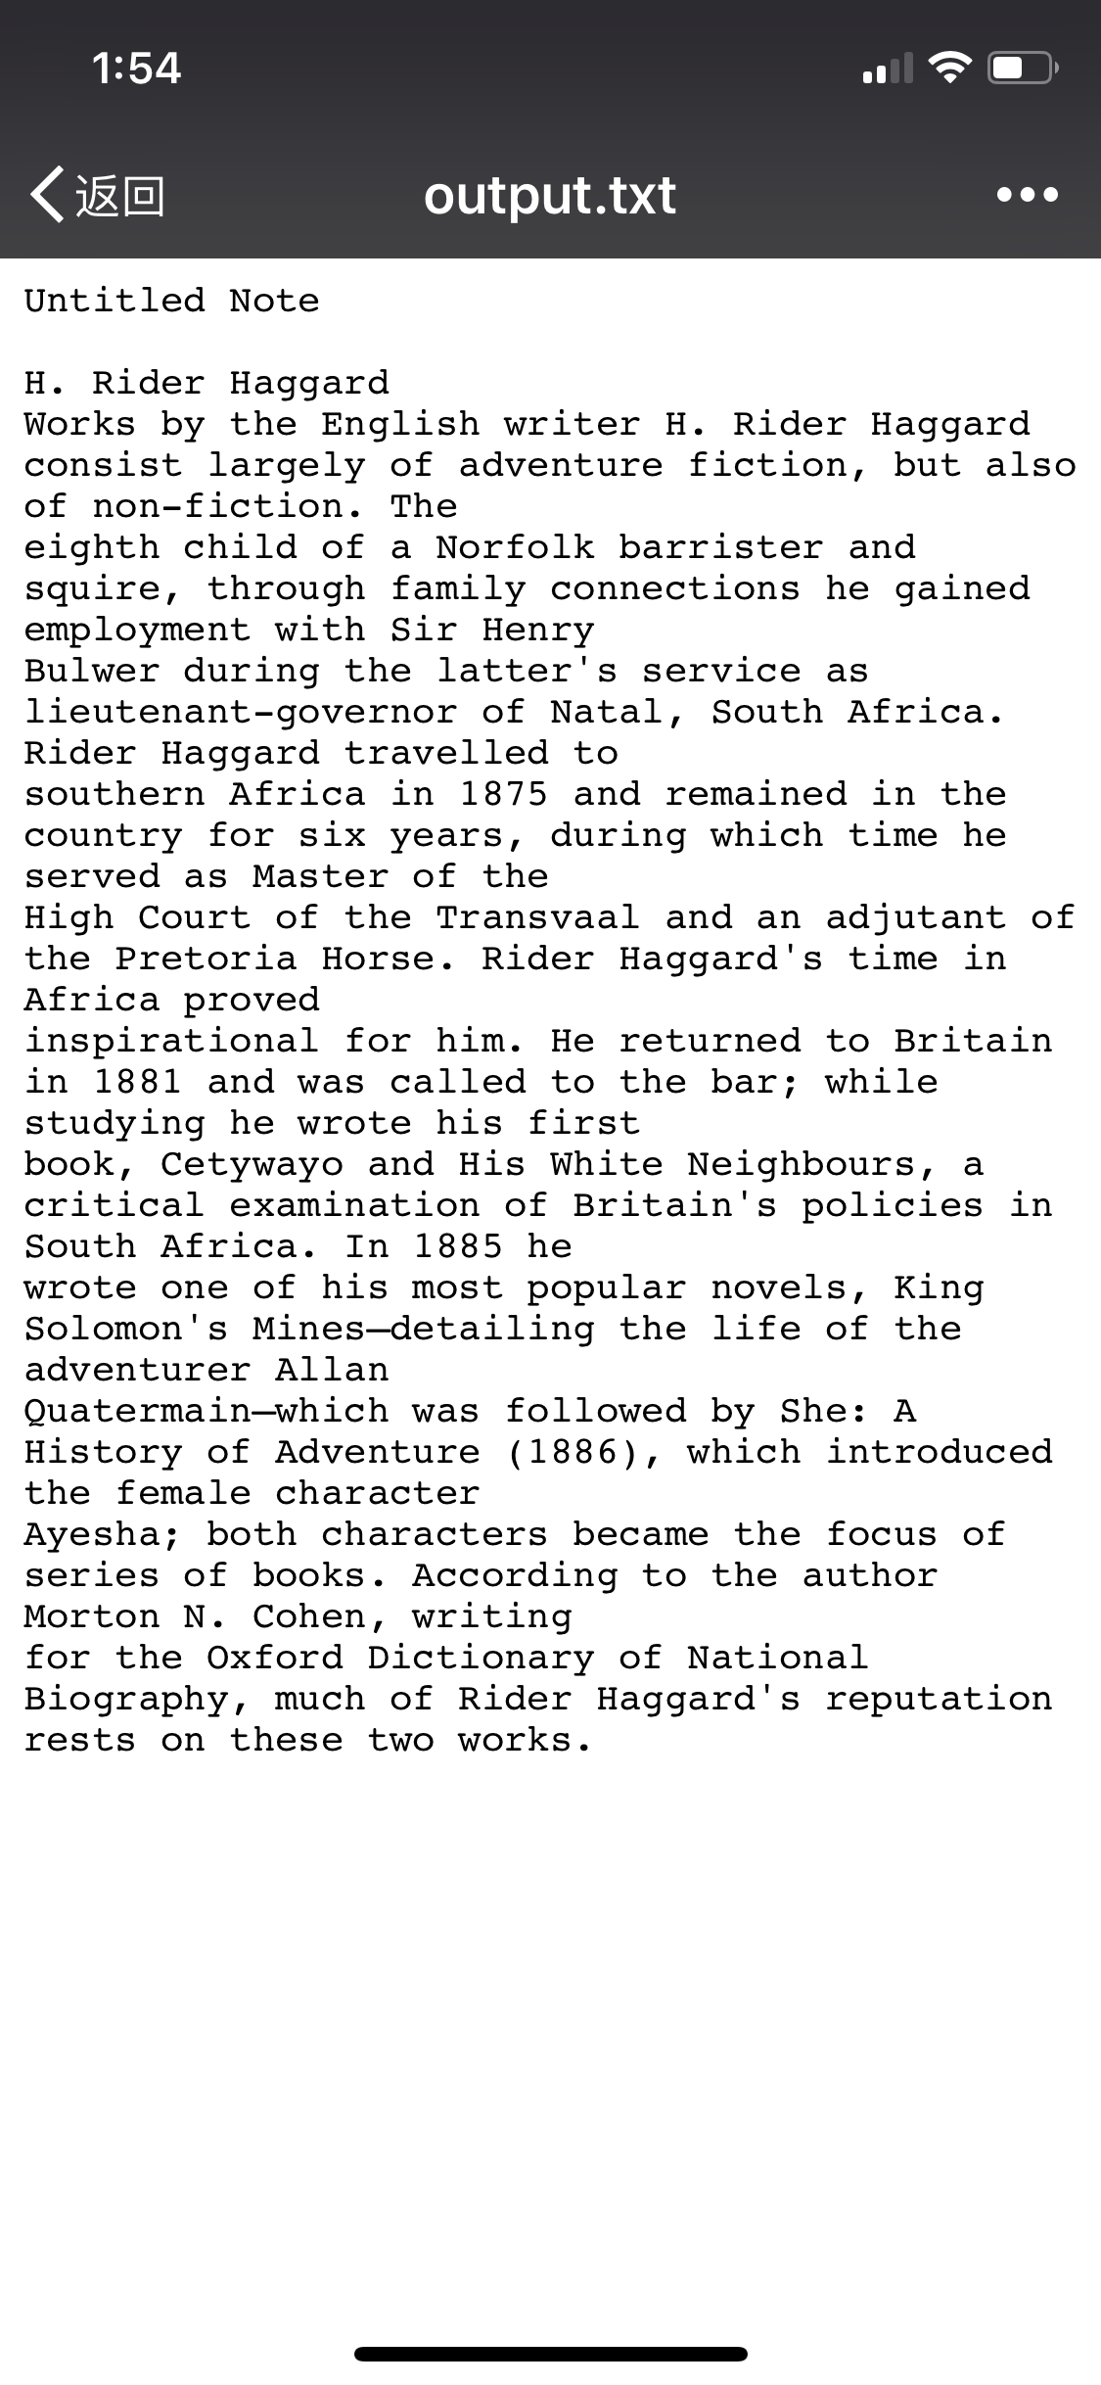
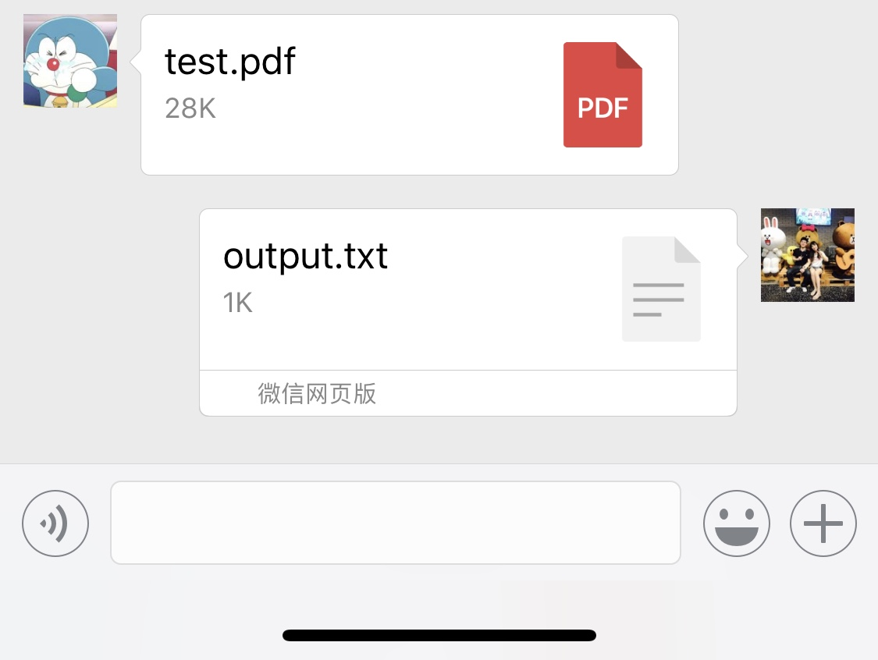
Function Demo-Part III : PDF transform

Slide 8
THANK YOU! Q&A

